Slide 1

Lecture #4

Slide 2




Line Drawing Techniques
www.tuf.edu.pk
unioffaisalabad

Slide 3
Line Drawing Techniques
Digital Differential Analyzer (DDA) Algorithm
Bresenham’s Line Algorithm
Incremental Line Algorithm

Slide 4
What is line & algorithm?
A line connects two points. It is a basic element in graphics.
To draw a line, you need two points between which you can draw a line.
Algorithm
Step by step procedure to solve a problem
An algorithm is well-defined list of steps for solving a particular problem.
Time and space it uses are two major measures of the efficiency of an algorithm.

Slide 5
Line incremental algorithm
An incremental line or increment line algorithm in computer graphics is a method of drawing lines where each new pixel is found using the previous one, instead of solving the whole line equation again and again.
This makes the process much faster and more efficient, especially when used in hardware.

Slide 6
Line incremental algorithm
Step 1. currposition=start
Step =increment
Step 2. if (currposition-end<accuracy)
then go to step
if (currposition<end) then go to step 3
if(currposition>end) then go to step 4
Step 3. currposition =currposition+ step
go to step 2
Step 4. currposition=currposition- step
go to step2
Step 5. Stop
Notes:
Set current position = start Set step = increment
Check how close the current position is to the end:
If the difference is smaller than the required accuracy, stop (we’re done).
If current position < end, go to Step 3.
If current position > end, go to Step 4.
If the position is smaller than the end:
Increase current position = current position + step
Go back to Step 2.
If the position is greater than the end:
Decrease current position = current position - step
Go back to Step 2.
Stop.

Slide 7
Line incremental algorithm
It works by incrementally moving from a starting position (start) toward an ending position (end), using a fixed step size (called increment).
It doesn’t calculate the entire line equation each time — instead, it uses the previous point to get the next one, which makes it faster and more efficient.
Notes:
Set current position = start Set step = increment
Check how close the current position is to the end:
If the difference is smaller than the required accuracy, stop (we’re done).
If current position < end, go to Step 3.
If current position > end, go to Step 4.
If the position is smaller than the end:
Increase current position = current position + step
Go back to Step 2.
If the position is greater than the end:
Decrease current position = current position - step
Go back to Step 2.
Stop.

Slide 8
Line incremental algorithm
Calculate the Slope (m)
m=dy/dx
This slope tells how steep the line is that is, how much Y changes when X increases by 1.
Notes:
Set current position = start Set step = increment
Check how close the current position is to the end:
If the difference is smaller than the required accuracy, stop (we’re done).
If current position < end, go to Step 3.
If current position > end, go to Step 4.
If the position is smaller than the end:
Increase current position = current position + step
Go back to Step 2.
If the position is greater than the end:
Decrease current position = current position - step
Go back to Step 2.
Stop.

Slide 9
Line incremental algorithm
When drawing a line between two points — say (x1, y1) and (x2, y2) — we need to know how much we move in each iteration, i.e., our step size.
We can’t just move by 1 in both directions because sometimes:
The line is more horizontal (moves more in X)
Or more vertical (moves more in Y)
So we need to figure out which direction dominates — X or Y — and adjust our step accordingly.
Dominant cordinate
dx = x2 - x1;
dy = y2 - y1;
Notes:
Set current position = start Set step = increment
Check how close the current position is to the end:
If the difference is smaller than the required accuracy, stop (we’re done).
If current position < end, go to Step 3.
If current position > end, go to Step 4.
If the position is smaller than the end:
Increase current position = current position + step
Go back to Step 2.
If the position is greater than the end:
Decrease current position = current position - step
Go back to Step 2.
Stop.

Slide 10
Line incremental algorithm
Case 1: |m| < 1 → Line is more horizontal
That means X changes faster than Y.
We take 1 step in X each time, and compute Y using slope:
x = x + 1;
y = y + m;
Case 2: |m| > 1 → Line is more vertical
That means Y changes faster than X.
We take 1 step in Y each time, and compute X using reciprocal of slope:
y = y + 1;
x = x + (1/m);
Notes:
Set current position = start Set step = increment
Check how close the current position is to the end:
If the difference is smaller than the required accuracy, stop (we’re done).
If current position < end, go to Step 3.
If current position > end, go to Step 4.
If the position is smaller than the end:
Increase current position = current position + step
Go back to Step 2.
If the position is greater than the end:
Decrease current position = current position - step
Go back to Step 2.
Stop.

Slide 11
Line incremental algorithm
Case 3: |m| = 1 → 45° diagonal line
X and Y change equally:
x = x + 1;
y = y + 1;
Notes:
Set current position = start Set step = increment
Check how close the current position is to the end:
If the difference is smaller than the required accuracy, stop (we’re done).
If current position < end, go to Step 3.
If current position > end, go to Step 4.
If the position is smaller than the end:
Increase current position = current position + step
Go back to Step 2.
If the position is greater than the end:
Decrease current position = current position - step
Go back to Step 2.
Stop.

Slide 12
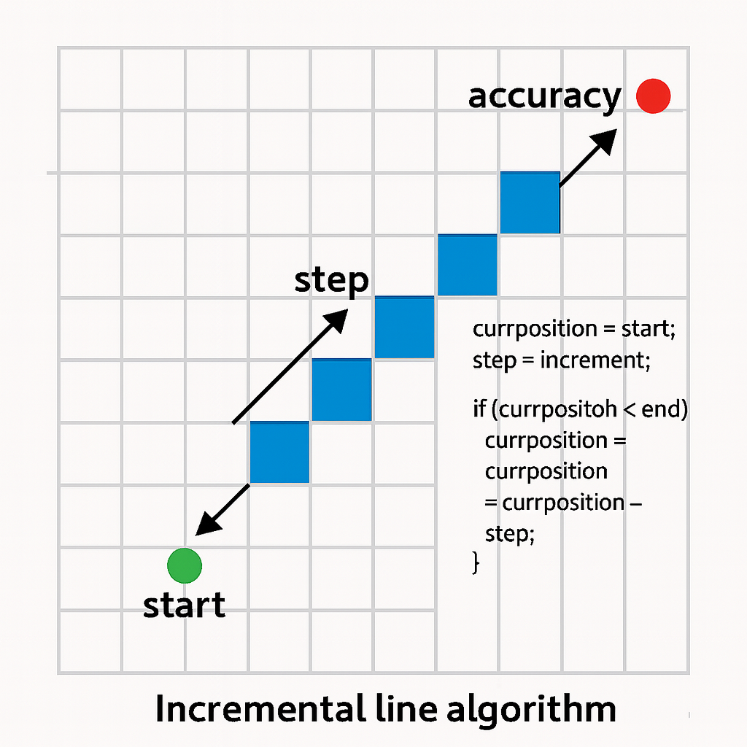
Line incremental algorithm
Notes:
Set current position = start Set step = increment
Check how close the current position is to the end:
If the difference is smaller than the required accuracy, stop (we’re done).
If current position < end, go to Step 3.
If current position > end, go to Step 4.
If the position is smaller than the end:
Increase current position = current position + step
Go back to Step 2.
If the position is greater than the end:
Decrease current position = current position - step
Go back to Step 2.
Stop.

Slide 13
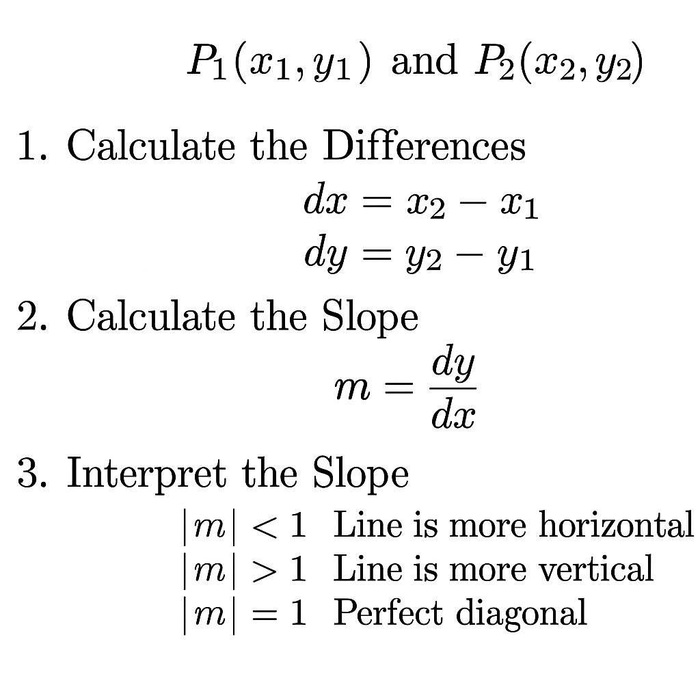
Line Drawing Algorithm

Slide 14
DDA (Digital Differential Analyzer) Line Drawing Algorithm
The Digital Differential Analyzer (DDA) is a line-drawing algorithm used in computer graphics to draw a straight line between two points on the screen.
It’s called “digital” because it works on pixels (digital points), and “differential analyzer” because it uses differences (increments) to calculate the next point from the previous one.
It starts at the starting point (x₁, y₁) and keeps adding a fixed increment (change in x and y) until it reaches the end point (x₂, y₂).

Slide 15
DDA (Digital Differential Analyzer) Line Drawing Algorithm
Step1: Start Algorithm
Step2: Declare x₁,y₁,x₂,y₂,dx,dy,x,y as integer variables.
Step3: Enter value of x₁,y₁,x₂,y₂.
Step4: Calculate dx = x₂-x₁
Step5: Calculate dy = y₂-y₁
Step6: Calculate the Slope m= Dy/dx
Case1: When |M|<1 then :
_{Xn =X+1}
_{Yn =y+m}

Slide 16
DDA (Digital Differential Analyzer) Line Drawing Algorithm
DDA Algorithm Step 1 - Calculate Differences dx = x2 - x1 dy = y2 - y1
Step 2 - Find Steps steps = maximum of absolute(dx) and absolute(dy)
Step 3 - Calculate Moves Per Step x_move = dx / steps y_move = dy / steps
Step 4 - Draw Line x = x1 y = y1

Slide 17
DDA (Digital Differential Analyzer) Line Drawing Algorithm
Plot pixel at (round(x), round(y))
Repeat from 1 to steps: x = x + x_move y = y + y_move Plot pixel at (round(x), round(y))
Loop repeats = steps times

Slide 18
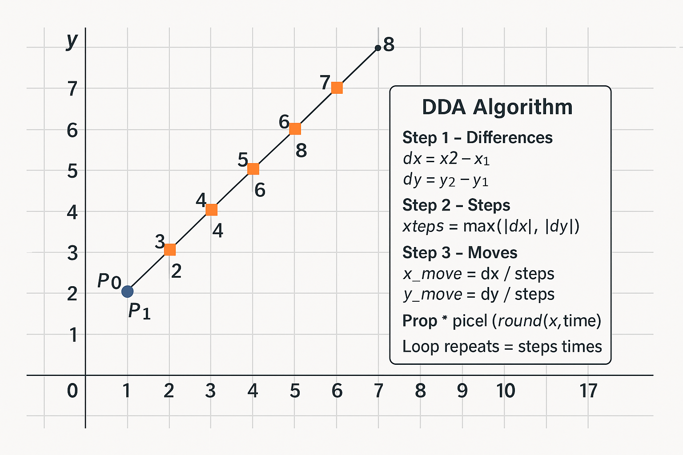
DDA (Digital Differential Analyzer) Line Drawing Algorithm

Slide 19
Advantages of DDA
It is a faster method when compared to direct use of line equation.
This method does not use multiplication .
It allows us to detect the change in value of x and y , so plotting of same point twice is not possible.
This method gives overflow indication when a point is repositioned.
It is can easy method because each step involves just two additions.

Slide 20
Disadvantages of DDA
It involves floating point addition, rounding of done. Accumulation of round off cause errors.
Rounding of operation and floating point operations consumes a lot of time.
It is more suitable generating line using the s/w. But it is less suited for H/w implementation.

